Slide 1
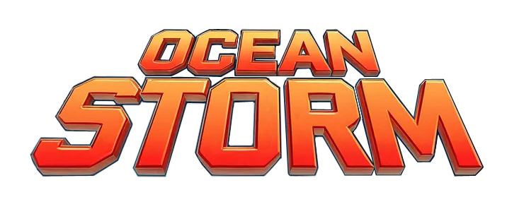
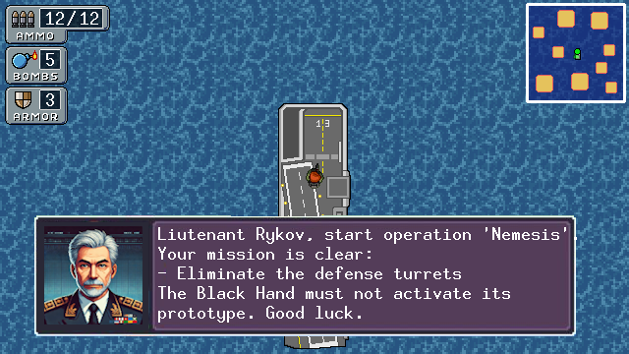
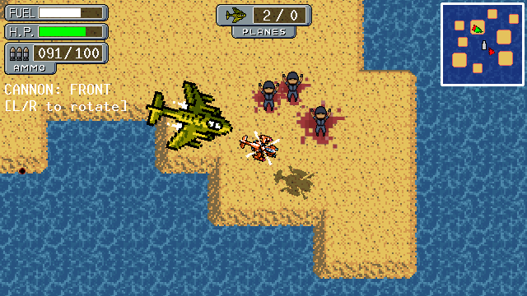
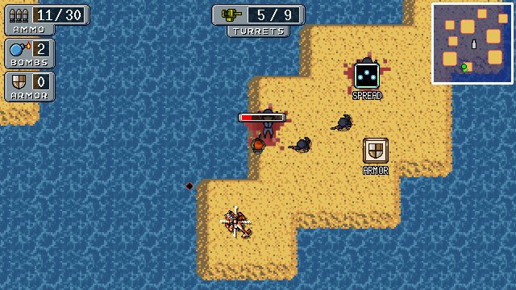
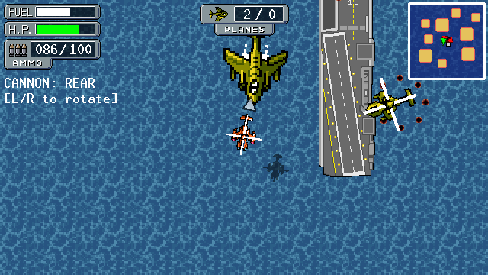

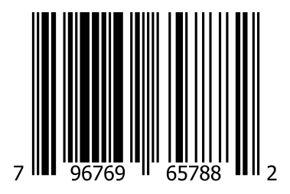
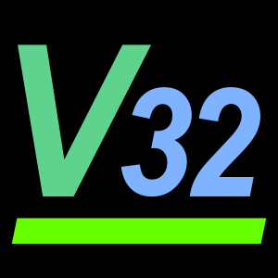
Thalassa island needs your help to be liberated!
The Black Hand militia has taken over Thalassa. Now they dominates this territory with soldiers, defensive turrets, fighter jets and helicopters. It is up to you to claim back the land from them.
Join elite pilot Alex Rykov and his commander in an effort to fight this menace. You can shoot, run, place bombs and pilot a helicopter. Use the carrier to heal and pick up different weapons!
Both the islands map and the enemy soldiers are randomly generated to allow you to have a different adventure every time. And all dialogs and texts are available in English and Spanish.
This game is free and open source!
Get the game binaries and source code online.
CONTAINS ONLY INSTRUCTIONS
IN ENGLISH
Only for use with Vircon32 consoles.
Not compatible with other systems.
This seal is your guarantee that this product’s quality has been ensured by the Vircon32 community.
GAME SUITABLE FOR ALL AGES

